Slide 1
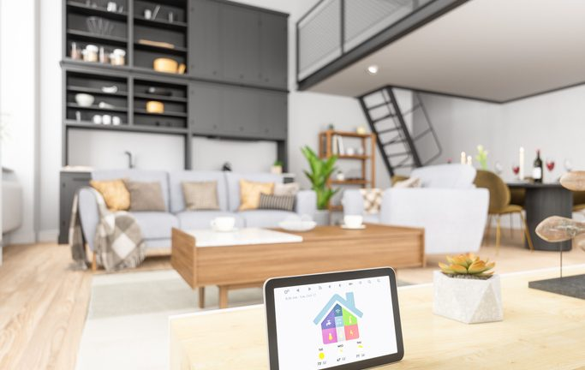
Tech Prodigy Inc.
Project:
Ambient Student
House

Slide 2
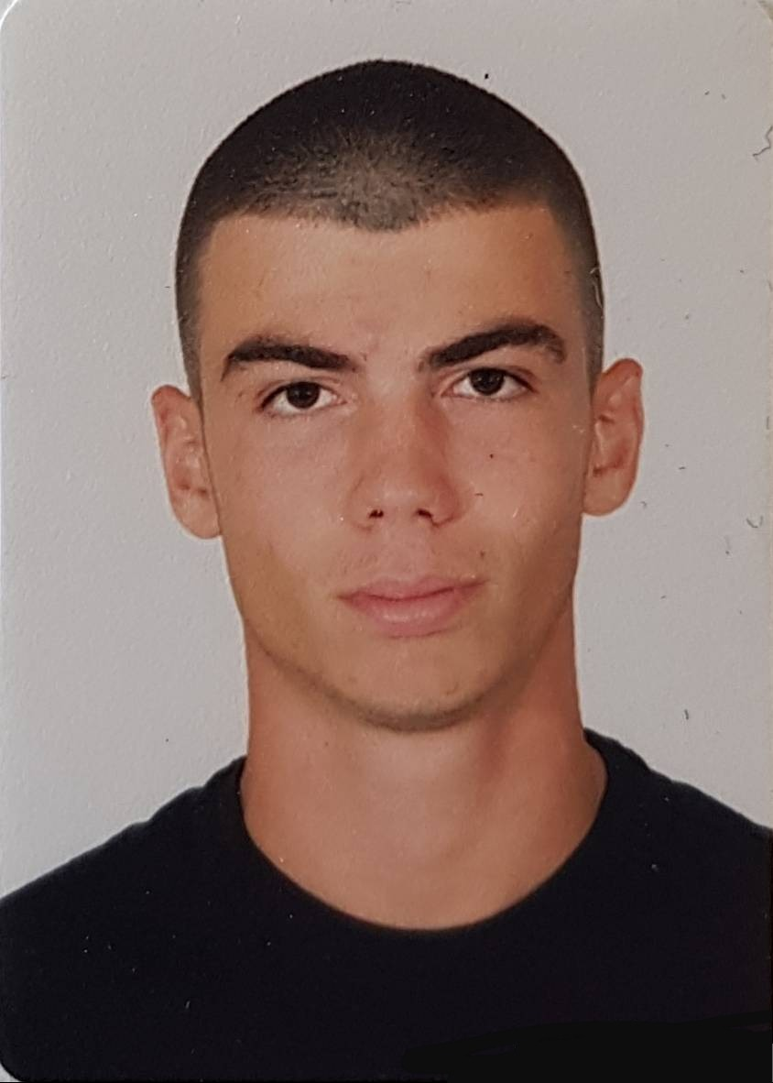
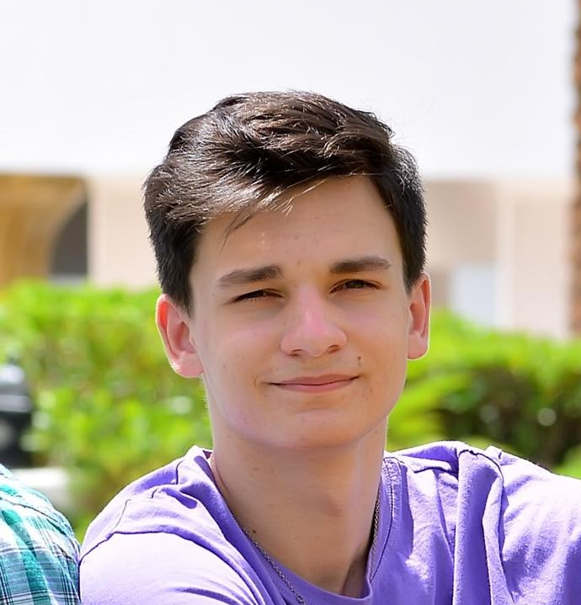

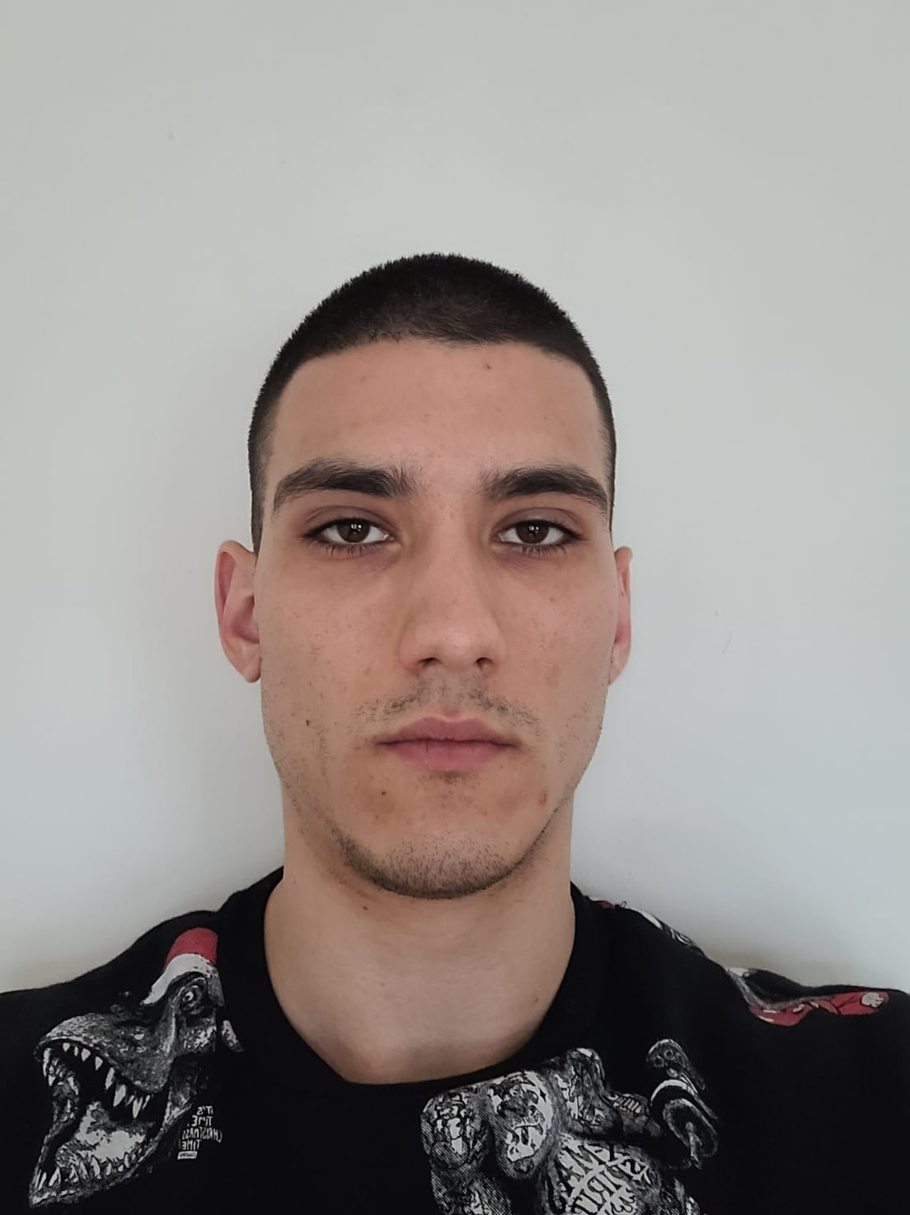
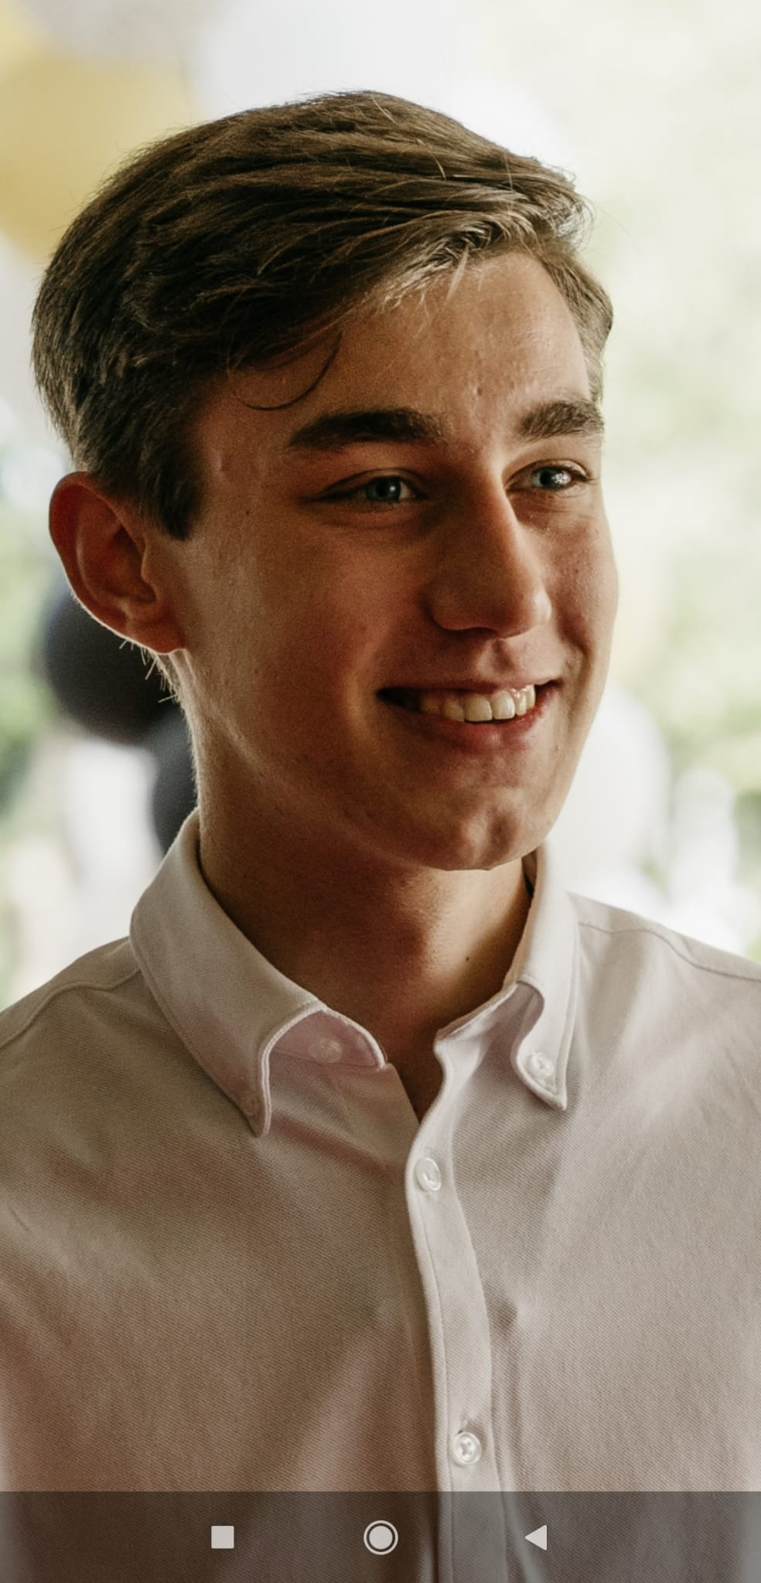
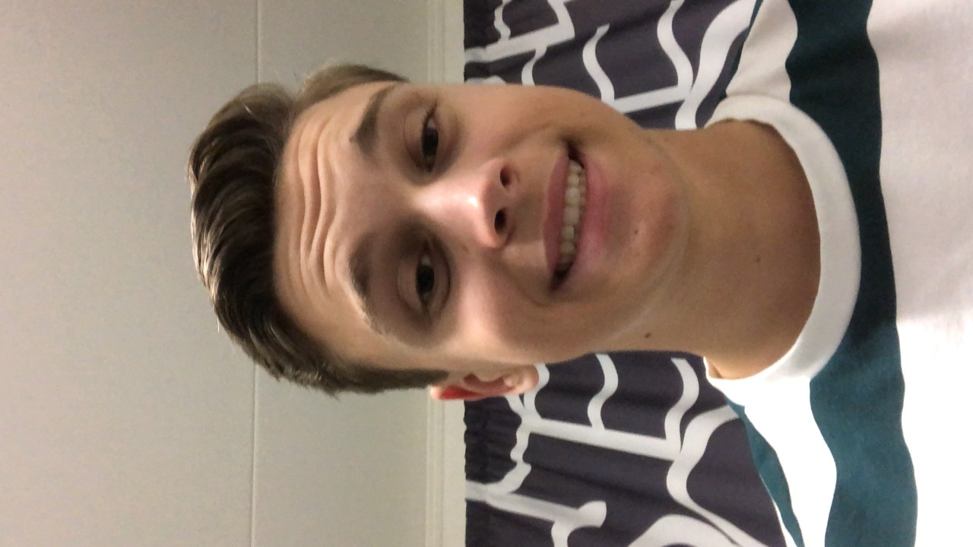
Our team
Stefan Andonov
July Trendafilov
Misha Rozkvas
Chiem Dings
Nick Mulders
Stefan is an embedded programmer specializing in C/C++
July knows a lot about C, C# and C++ and also assists in debugging where needed
Misha is our C coder that programs sensors for easier use of household devices
Chiem is our C# developer and
played a big role in integrating all the components together
Nick is our c/c++ programmer who programs smart home devices

Slide 3
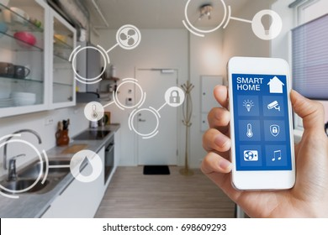
Introduction
Our goal
Main Features
We automated your stay at the ambient student house, providing you with a cozy and comfortable experience
Reception
Doorlock system
Fire alarm
Ambient lighting system
Vending machine
Bathroom

Slide 4
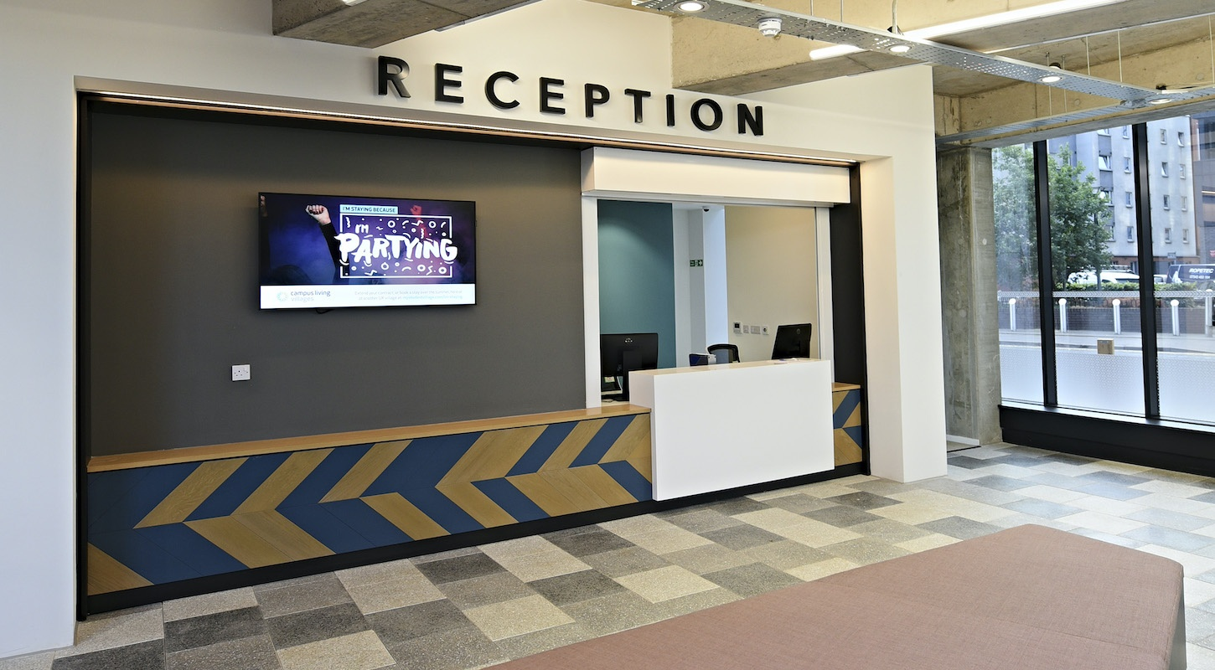
Reception
Fast registration and de-registration
Simple user interface
Remotely control features

Slide 5
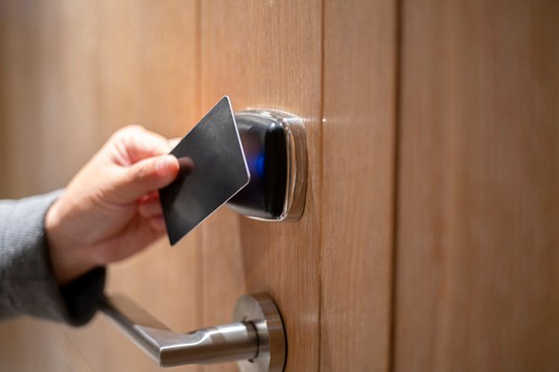
Doorlock
State-of-the-art locking mechanism in each bedroom
Upon break-in the alarm sounds automatically

Slide 6

Fire alarm
Trustworthy
Safe
Easy to maintain

Slide 7

Lighting system
Intuitive
Ambient
Interactive
Fun to use!

Slide 8
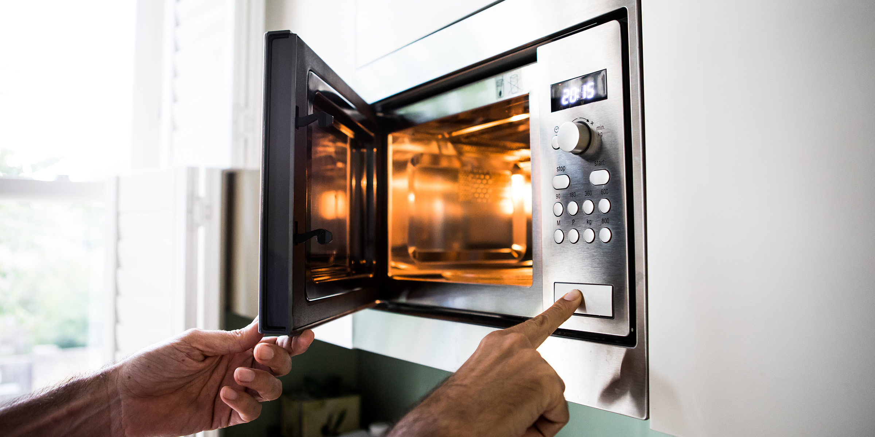
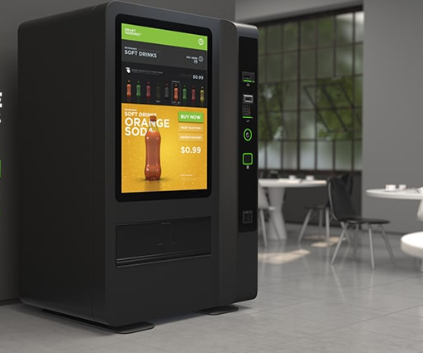
Vending machine
Easy to use
Clear user interface
Microwave
Convenient
Powerful

Slide 9
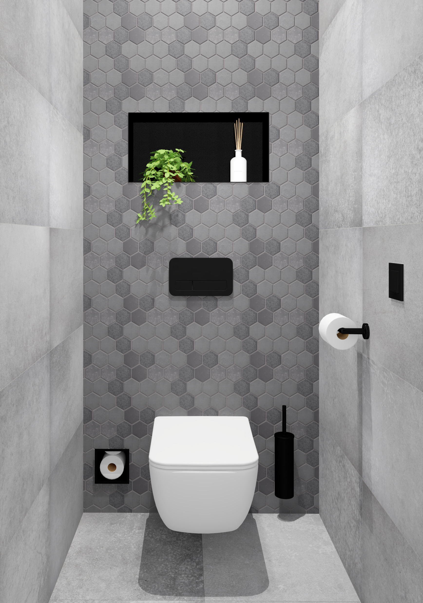
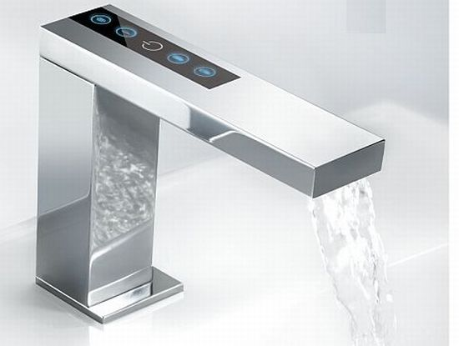
Bathroom and toilet
Authentic
Innovative
First of its kind

Slide 10
Final word
01
02
First on the market
High demand
03
04
Robust system
Vastly marketable
05
Comprehensible

Slide 11
Are there any questions?

